Slide 1

Multivariable Regression & Pre-Processing
Machine Learning 2023-2024
Lab 3

Slide 2
Agenda
Multivariable Linear Regression
Preprocessing
FIFA 2019 Players Value Estimation Problem (Hands On)

Slide 3

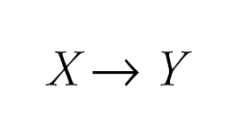
Multiple Linear Regression
Simple regression considers the relation between single independent variable and dependent variable.

Slide 4
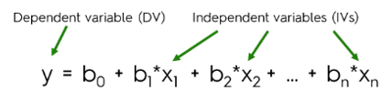
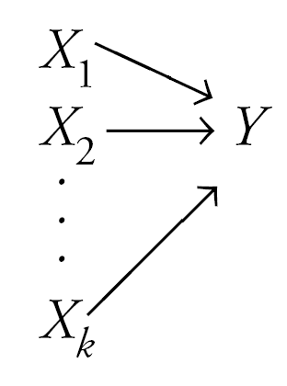
Multiple Linear Regression
Multiple regression considers the influence of multiple independent variables on a dependent variable Y.

Slide 5
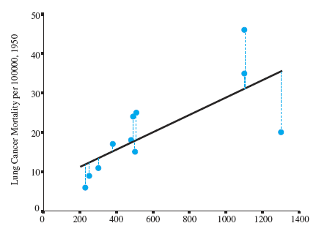
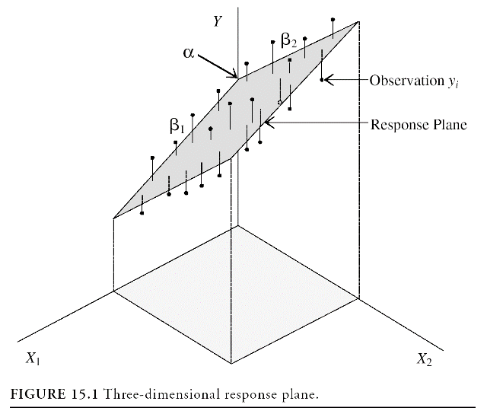
Multiple Linear Regression
A simple regression model (one independent variable) fits a regression line in 2-dimensional space.
A multiple regression model with two independent variables fits a regression plane in 3-dimensional space.

Slide 6
Multiple Linear Regression
Multiple linear regression looks at the relationships within a bunch of information. Instead of just looking at how one thing relates to another thing (simple linear regression).
Multiple regression analysis has three main uses:-
You can look at the strength of the effect of the independent variables on the dependent variable.
You can use it to ask how much the dependent variable will change if the independent variables are changed.
You can also use it to predict trends and future values.

Slide 7

FIFA 2019 Players Value Estimation Problem
Objective: The dataset contains detailed attributes for every player registered in the latest edition of FIFA 19 database. Our goal is to create Linear and Polynomial Regression models to predict the value of the player based on several attributes.

Slide 8
Preprocessing
Before building our regression models, we need to make sure that the dataset is clean and ready-to-use.
Preprocessing :
Analyze the samples and check if there are null values or not.
How can you deal with the missing values ??
Feature Scaling
Encode the text features to numerical values (i.e “Club”, “Nationality”)
Feature understanding and Selection: (Next Lab)
Determine the best model that fit your data. How ?

Slide 9
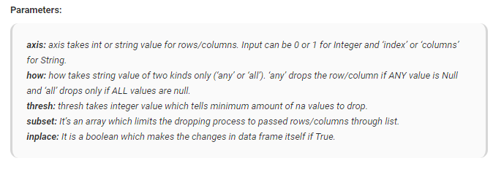
Preprocessing – Missing Values
To know which columns have missing values: DataFrame.isna().sum()
To remove them: DataFrame.dropna(axis=0, how=‘any’, thresh=None, subset=None, inplace=False)

Slide 10
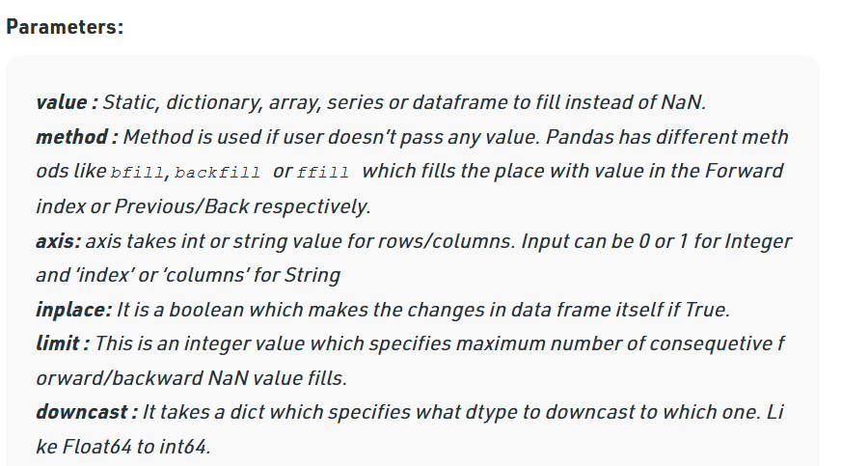
Preprocessing – Missing Values
Another method to deal with missing values is to fill the NaN values in column with a value such as the mean, median or mode of the column
We can choose which method to use to fill a column based on the nature of the column (numerical, categorical,..etc)
To fill the missing values: DataFrame.fillna(value=None, method=None, axis=None, inplace=False, limit=None, downcast=None)

Slide 11
Preprocessing - Feature Scaling
Feature Scaling is a technique to standardize the independent features present in the data in a fixed range. It is performed during the data pre-processing to handle highly varying magnitudes or values or units.
If feature scaling is not done, then a machine learning algorithm tends to weigh greater values, higher and consider smaller values as the lower values, regardless of the unit of the values.
Example: If an algorithm is not using feature scaling method then it can consider the value 3000 meter to be greater than 5 km but that’s actually not true and in this case, the algorithm will give wrong predictions. So, we use Feature Scaling to bring all values to same magnitudes and thus, tackle this issue.

Slide 12


Preprocessing - Feature Scaling
Techniques to perform Feature Scaling :-
Min-Max Normalization: This technique re-scales a feature or observation value with distribution value between 0 and 1.
Standardization: It is a very effective technique which re-scales a feature value so that it has distribution with 0 mean value and variance equals to 1.

Slide 13
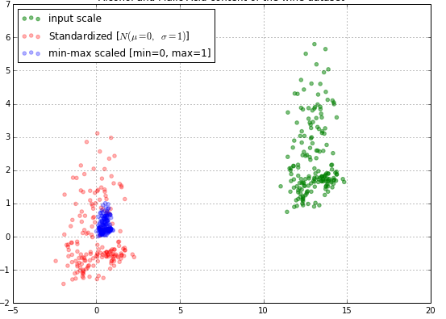
Preprocessing - Feature Scaling

Slide 14
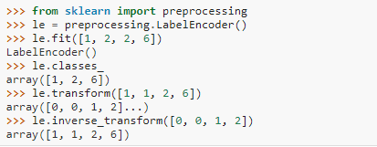
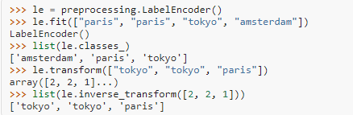
Preprocessing - Encoding
LabdelEncoder : can be used to normalize labels.
It can also be used to transform non-numerical labels to numerical labels.

Slide 15
Thank You

